Slide 1
Learning Python Applications Development for Industrial Projects (LPADIP-2019), M.N.N.I.T , Allahabad
Laptop Price Predictor
Group Members :
-Nikhil Shukla
-Md.Wasique Umar
- Abhay Singh
-Lakshya Saxena
-Pranav Misra
Notes:
<number>

Slide 2
INTRODUCTION
The idea of this project is pretty basic, and goes with its name, that is it estimates the price of a laptop with the specifications demanded by users. The aim is to use a given data to train the machine so that it can predict how much would any given specifications of the laptop, affect its total price.

Slide 3
WORKING
As we have integrated our Laptop Price Prediction model with a simple and user friendly Web-based Interface where we have provided different fields of specifications desired users in their Laptop, such as :
CPU Type
Operating System
Primary Memory (RAM)
Secondary Memory
GPU
Dimensions

Slide 4

Working Continued
The user is supposed to select from the given option fields, the various categorical requirements , and also specify the values of other attributes, they want in their laptop.
The model is trained so, that it will predict the most approximate price of the a laptop consisting of the specified features.
Tools Used :The tool used for the cleaning and analysis of original dataset is “Dataiku”.

Slide 5
PROCEDURE
Acquiring Data :
The very first step of our project was to collect data which we would be using to train our model. So we used a dataset from “Kaggle.com”
containing approximately 1300 rows of data, which related the price of any given Laptop with its specifications.
Preprocessing of Data :
Now, even though we had access to some already prepared data, it obviously required changes. To make the data suitable to be used in training the model, the very first requirement is to make sure the data is quantitative
So we processed the data into its adequate equivalent, suitable for computation.
Notes:
<number>

Slide 6
Cleaning :
After transforming data into a from convenient for computation, the data was cleaned in order to get rid of irrelevant data i.e, the data which was not affecting the price of the laptop or had a nominal effect on price.
In order to determine the variables or factors that were not really affecting the price of Laptops we used correlation matrix to ensure the inclusion of relevant data only.
Cleaning the data also included filling up for missing data using dummy variables.

Slide 7
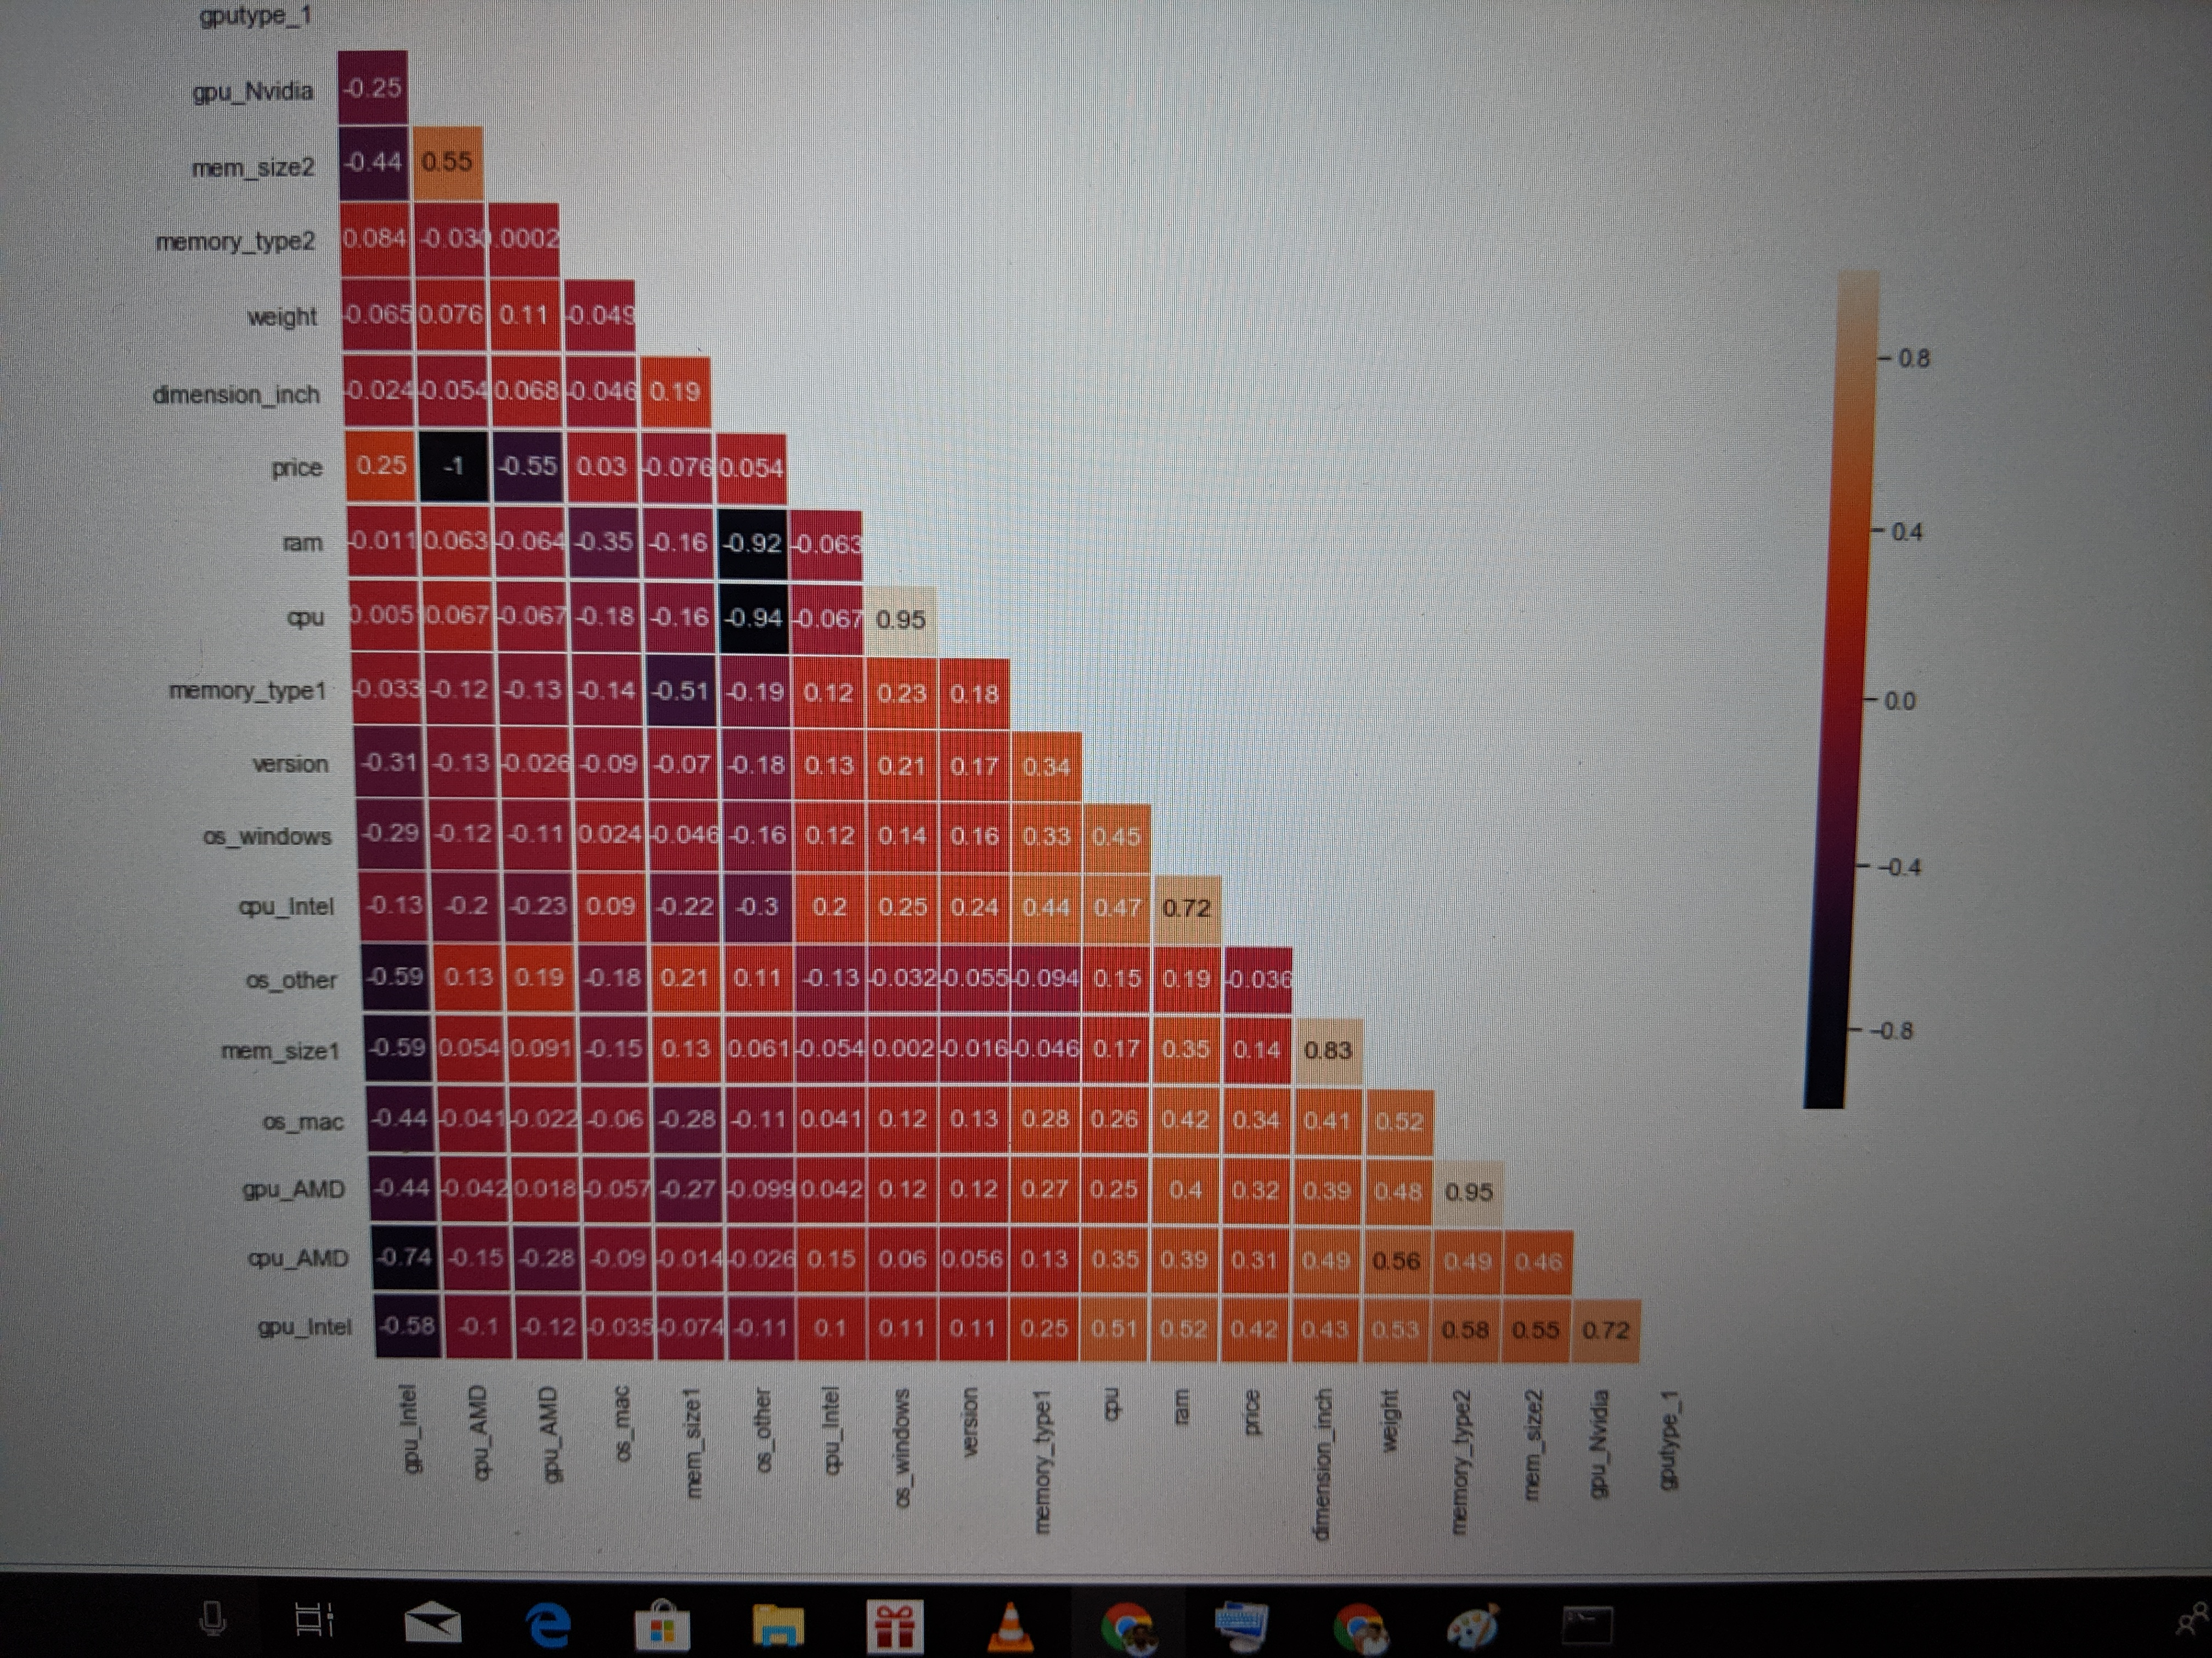
Cleaning and Preprocessing

Slide 8
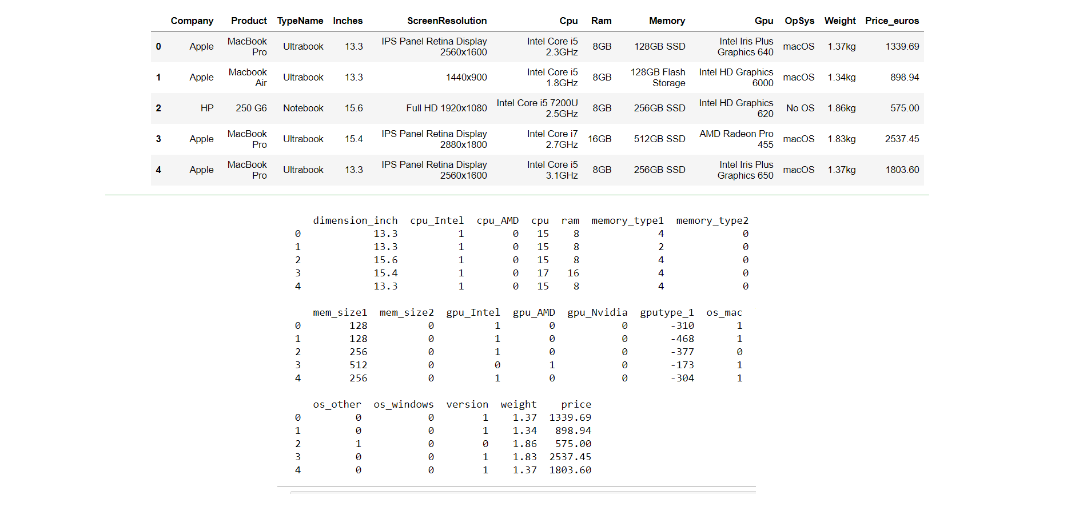

Slide 9
Analysis :
With the data prepared and ready for training our model, we analyzed our data using Dataiku. We used two algorithms
XGBoost (Extended Gradient Boost)
OLS (Ordinary Least Square)
On comparison we realized that XGBoost algorithm is best suited for our project as it showed more than 90% accuracy in every test, while OLS gave approximately 70% to 74% of accuracy.
A comparison of the accuracy of both the algorithms is attached on the next slide.

Slide 10
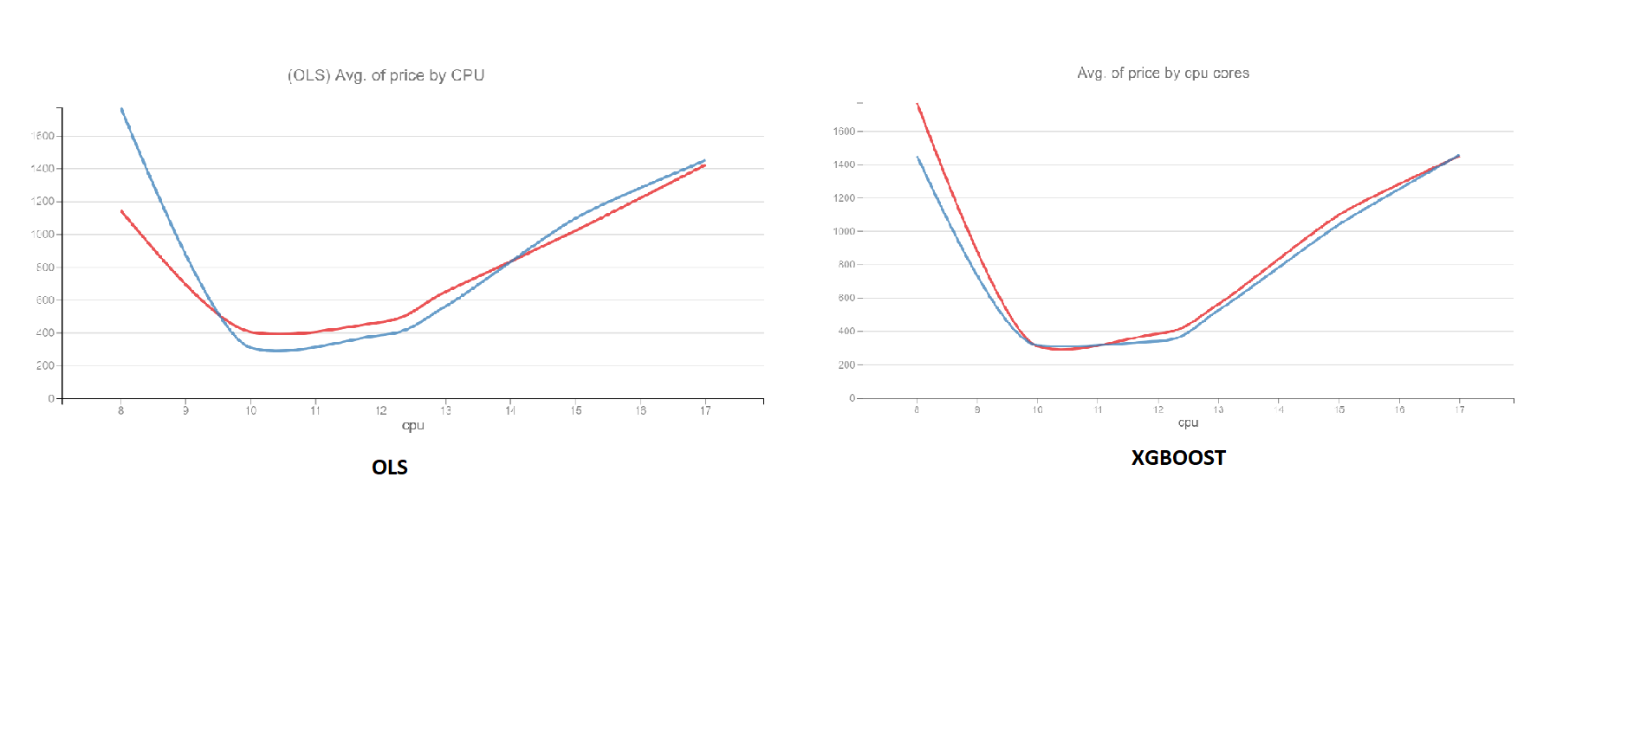
XGBoost v/s OLS

Slide 11
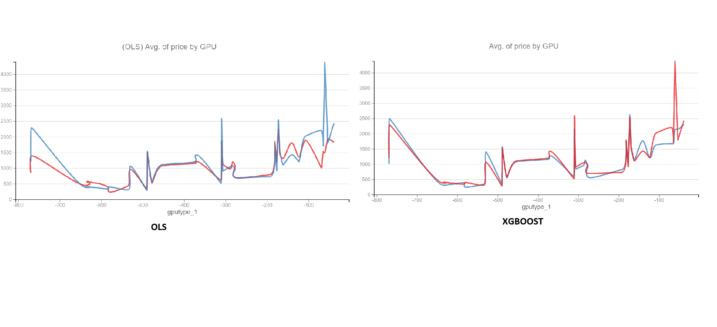
XGBoost v/s OLS

Slide 12
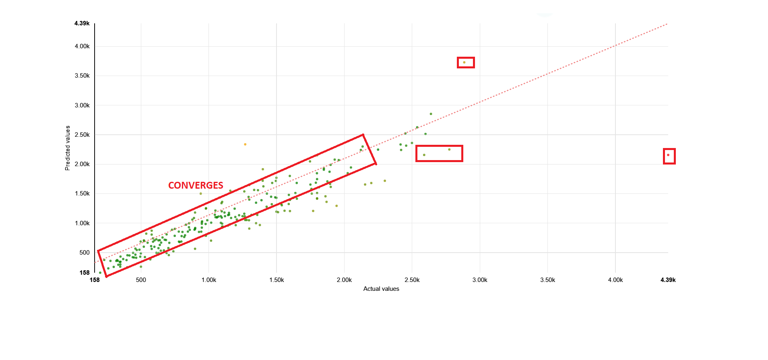
XGBoost Scatter Plot

Slide 13
Training and Testing of Model :
After we determined the best algorithm for our model, we trained our model splitting our data set in a ratio of 80% and 20% for training and testing respectively.
Integration With Front End :
Finally we integrated our trained model with a web interface with which user can interact, using flask library.

Slide 14

THANK YOU

